Slide 1
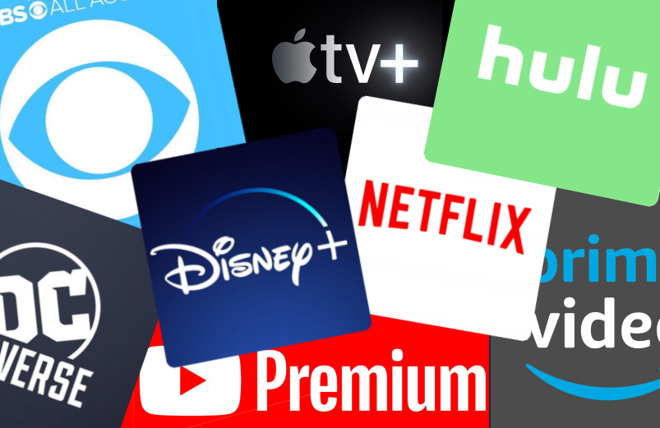
Disney+ Content Analysis
I
What are the use cases for this?
II
Recency Factor
This is necessary to ensure that the new platform keeps up with growing competitors such as Netflix, Hulu, or Amazon Prime.
We will be able to assess the type of content that will shape the future of the platform.
Something as old as Fantasia(1940) might not be as relevant as Moana(2016)
We can foresee which aspects of old content are still relevant when it comes to shaping modern content
Figure 1. Disney+ & competitors
Figure 2. Fantasia and Moana’s similar scenes

Slide 2
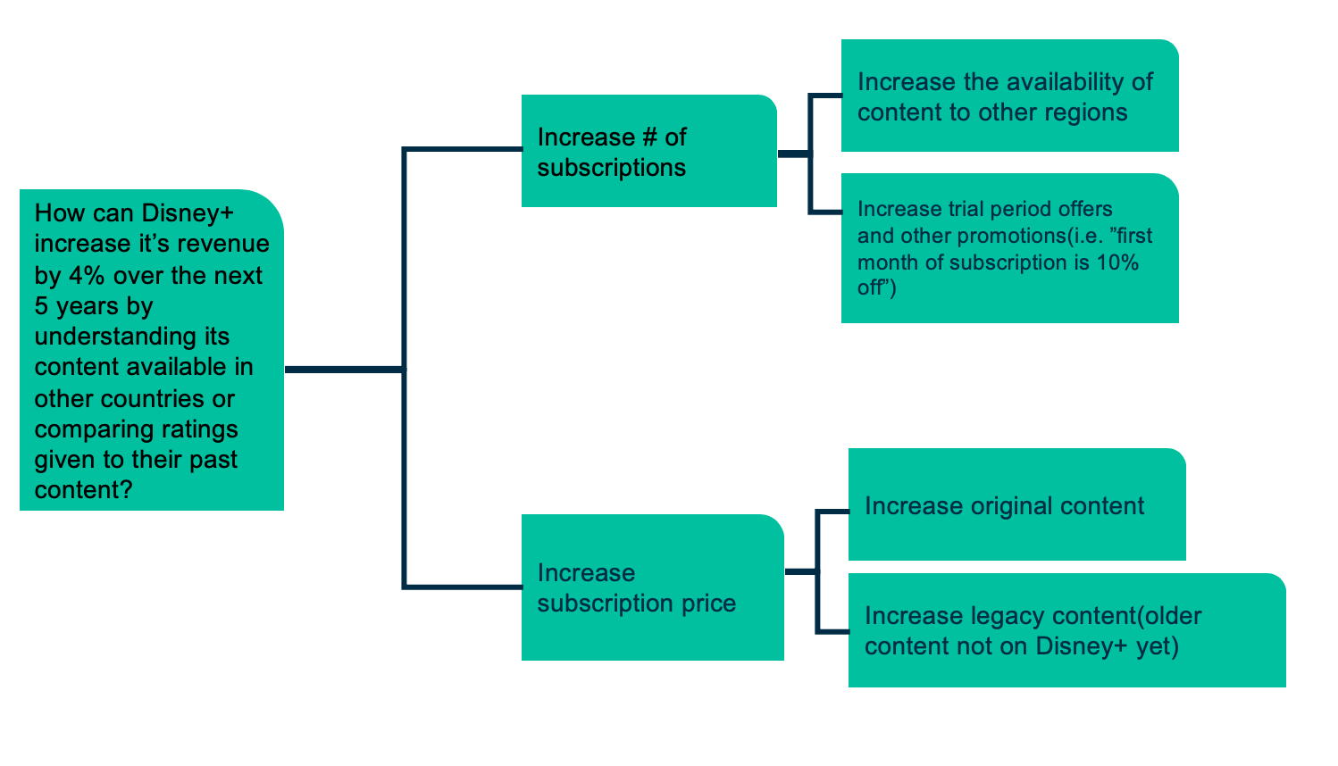
Disney+ Issue Tree
Notes:
* One slide that is interesting based on the use case
* Why this is required?
* Recency factor of data
* content tree nodes connect to financial benefit
* This is where financial unit comes in
* Increase subscription price

Slide 3
What are the most common genres?
3 Genre Columns Statistical Analysis
The Animation, Comedy, and Adventure are the most common genres in genre 1. Meanwhile, for genre 2, Family, Adventure, and Short are the most common. For genre 3, Family, Comedy, and Action are the most common.
Notes:
* explain genre 1, 2, & 3 * Labels for the x-axis and y-axis
* The first slide can talk about sorted genres in descending order
* Have a pivot of all the genres coming and the votes. Take a sum of votes and grouping by genre. Then take maximum votes by genre
* Circle top 3 genres
* Data labels on top bar

Slide 4
Which genres have the most votes?
In descending order, we have Action, Animation, Comedy, Adventure, and Biography as the top 5 highest votes in genre column 1. Meanwhile, Adventure, Family, Comedy, Drama, and Action have the top 5 highest votes in genre column 2.
Notes:
* explain genre 1, 2, & 3 * Labels for the x-axis and y-axis
* The first slide can talk about sorted genres in descending order
* Have a pivot of all the genres coming and the votes. Take a sum of votes and grouping by genre. Then take maximum votes by genre
* Circle top 3 genres
* Data labels on top bar

Slide 5
Which genres have the best ratings?
Descriptive Statistics for Top Rated Genres
This plot and table are important to show if our distribution of ratings is skewed and to determine potential outliers. We can see that there is a small distribution of ratings for the Biography genre for example, but its whisker or maximum value is 8.
Notes:
* Genres would be box plots
* Compare categories individually(i.e. Animation genre imdb ratings)

Slide 6
What is the relationship between content ratings and votes?
IMDB Votes vs Ratings/Awards Statistical Analysis
 | awards | nominations | metascore | imdb_votes | imdb_rating
awards | 1
nominations | 0.16669414 | 1
metascore | 0.01634406 | 0.20648601 | 1
imdb_votes | 0.05319537 | 0.44850072 | 0.10447781 | 1
imdb_rating | 0.11044952 | 0.30499355 | 0.45636868 | 0.20450819 | 1
There is a positive correlation between IMDB votes and ratings. Since we know more votes equals higher ratings, content with more votes can be associated with highly awarded content genre’s such as Action, Animation, or Comedy. However, there it is in fact a weak correlation based on the r value of 0.20450819. If it was a value closer to 1 such as 0.3, it would have a stronger correlation.
Notes:
* Talk about why this is required
* Hypothesis where imdb votes is higher then imdb rating is higher
* There is a high correlation
* Swap awards and imdb votes
* Hypothesis: the higher imdb ratings, the more imdb votes
* Include technical jargon especially correlation coefficient

Slide 7
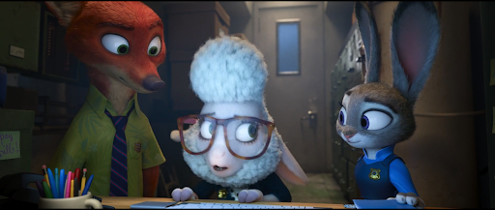
Conclusions
The most common genres are Animation, Comedy, and Adventure
The genres with the highest votes are Action, Animation, Comedy, Adventure, and Biography
Based off the the highest votes, the genres with the highest ratings are Animation, Action, Adventure, Comedy, and Biography
There is a positive correlation between IMDB votes and ratings. Therefore, the higher the votes, the higher the ratings are for individual content.
Thank you for listening to my presentation!
Notes:
* Don't include "I have determined"
* Funneling down my analysis, these genres have done the best
* Reinforce hypothesis
* single sentence
* add on to bullet points, don't just read
* try to relate to audience

